Slide 1
UNIT – 3 INTRODUCTION TO SQL
Copyright © 2014 Pearson Education, Inc.
‹#›

Slide 2
OBJECTIVES
Define terms
Interpret history and role of SQL
Define a database using SQL data definition language
Write single table queries using SQL
Establish referential integrity using SQL
Discuss SQL:1999 and SQL:2008 standards
‹#›

Slide 3
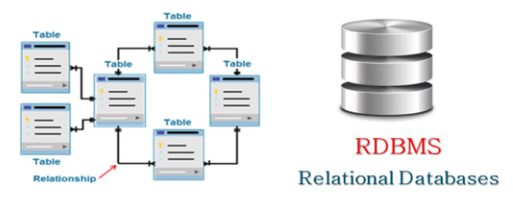
SQL OVERVIEW
Structured Query Language
The standard for relational database management systems (RDBMS)
RDBMS: A database management system that manages data as a collection of tables in which all relationships are represented by common values in related tables
‹#›

Slide 4
HISTORY OF SQL
1970–E. F. Codd develops relational database concept
1974-1979–System R with Sequel (later SQL) created at IBM Research Lab
1979–Oracle markets first relational DB with SQL
1981 – SQL/DS first available RDBMS system on DOS/VSE
Others followed: INGRES (1981), IDM (1982), DG/SGL (1984), Sybase (1986)
1986–ANSI SQL standard released
1989, 1992, 1999, 2003, 2006, 2008–Major ANSI standard updates
Current–SQL is supported by most major database vendors
‹#›

Slide 5
BENEFITS OF A STANDARDIZED RELATIONAL LANGUAGE
Reduced training costs
Productivity
Application portability
Application longevity
Reduced dependence on a single vendor
Cross-system communication
‹#›

Slide 6
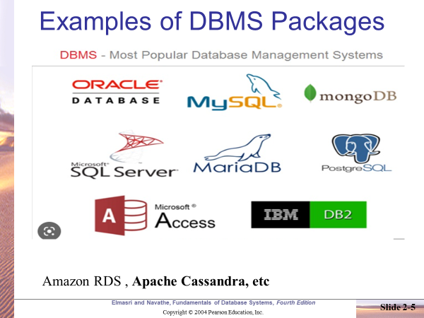

Slide 7
STRUCTURED QUERY LANGUAGE (SQL)
Categories of SQL function
Data definition language (DDL)
Data manipulation language (DML)
Nonprocedural language with basic command vocabulary set of less than 100 words
Differences in SQL dialects are minor
‹#›
Notes:
‹#›

Slide 8
SQL ENVIRONMENT
Catalog
A set of schemas that constitute the description of a database
Schema
The structure that contains descriptions of objects created by a user (base tables, views, constraints)
Data Definition Language (DDL)
Commands that define a database, including creating, altering, and dropping tables and establishing constraints
Data Manipulation Language (DML)
Commands that maintain and query a database
Data Control Language (DCL)
Commands that control a database, including administering privileges and committing data
‹#›

Slide 9
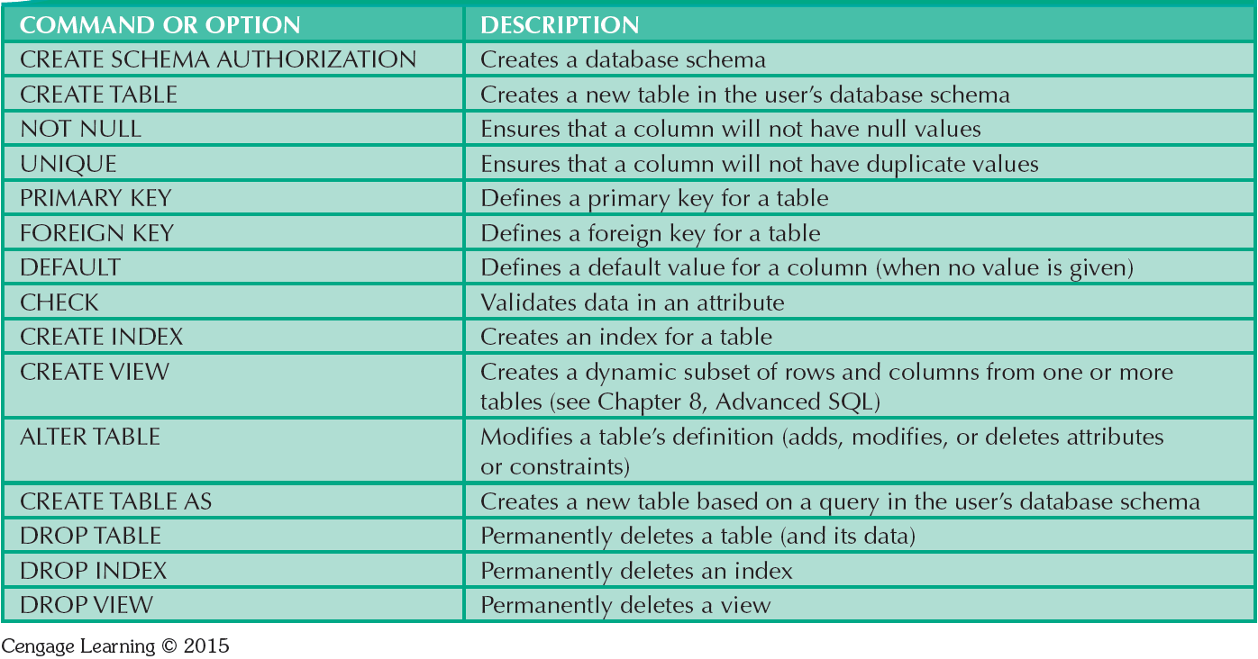
TABLE 7.1 - SQL DATA DEFINITION COMMAND
‹#›

Slide 10
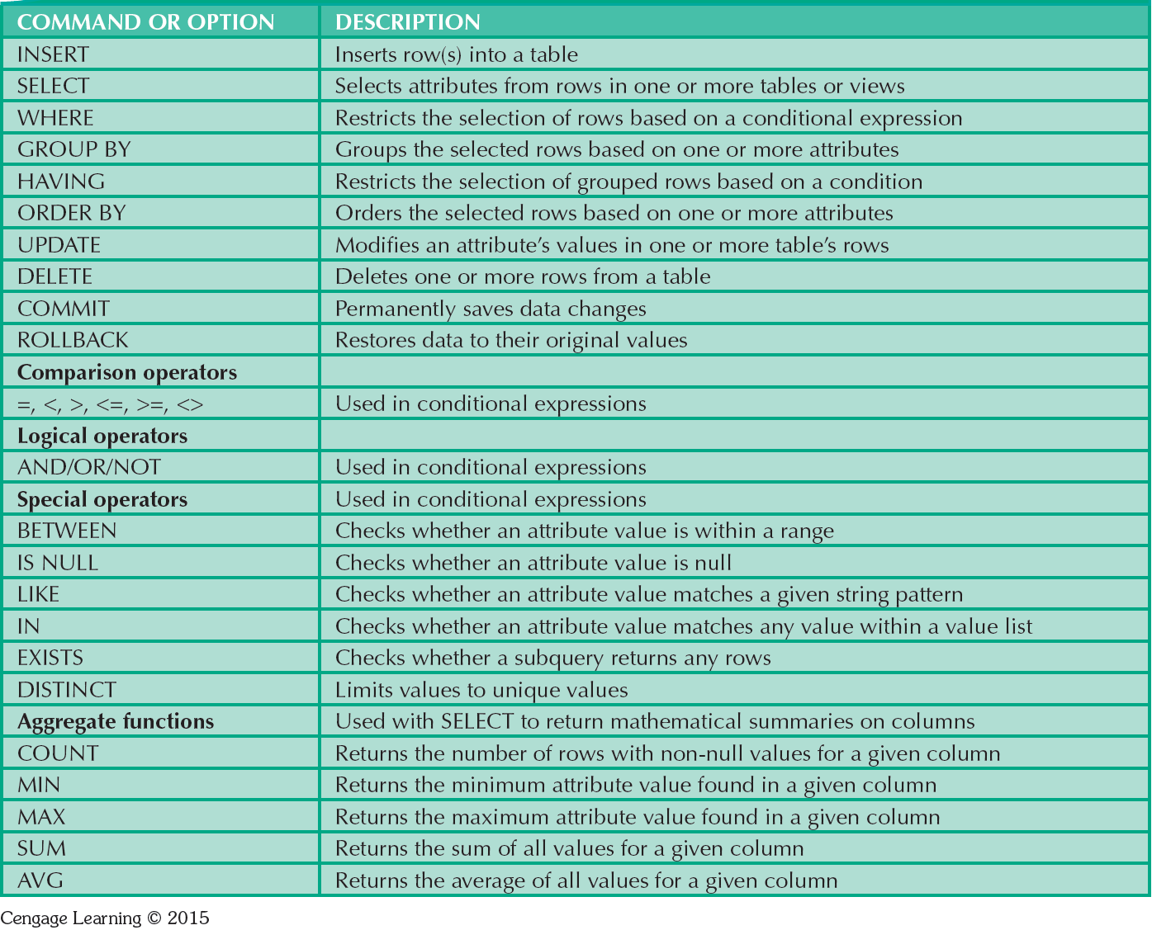
TABLE 7.2 - SQL DATA MANIPULATION COMMANDS
‹#›

Slide 11
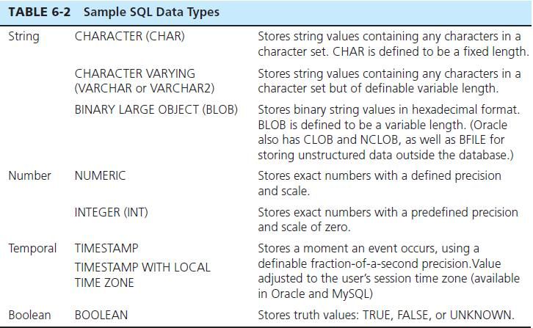
SQL DATA TYPES
‹#›

Slide 12
SQL DATABASE DEFINITION
Data Definition Language (DDL)
Major CREATE statements:
CREATE SCHEMA–defines a portion of the database owned by a particular user
CREATE TABLE–defines a new table and its columns
CREATE VIEW–defines a logical table from one or more tables or views
Other CREATE statements: CHARACTER SET, COLLATION, TRANSLATION, ASSERTION, DOMAIN
‹#›

Slide 13
STEPS IN TABLE CREATION
Identify data types for attributes
Identify columns that can and cannot be null
Identify columns that must be unique (candidate keys)
Identify primary key–foreign key mates
Determine default values
Identify constraints on columns (domain specifications)
Create the table and associated indexes
‹#›

Slide 14
CREATING TABLE STRUCTURES
CREATE TABLE tablename();
CREATE TABLE table_name (
column_1 data_type column_constraint,
column_2 data_type column_constraint,
...
table_constraint );
‹#›
Notes:
‹#›

Slide 15
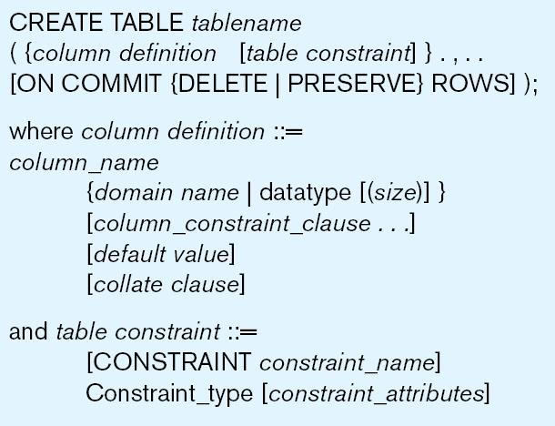
Figure 6-5 General syntax for CREATE TABLE statement used in data definition language
‹#›

Slide 16
EXAMPLES FOR CREATING TABLE
CREATE TABLE Students ( SID number(10) NOT NULL,
student_name varchar2(50) NOT NULL,
city varchar2(50)
);
DROP TABLE Students;
Exercise: Create Student table with variations;
‹#›

Slide 17
REMOVING TABLES
DROP TABLE statement allows you to remove tables from your schema:
DROP TABLE CUSTOMER_T
‹#›

Slide 18
INSERTING VALUES INTO TABLE
INSERT INTO table_name (column1, column2, column3, ...) VALUES (value1, value2, value3, ...);
INSERT INTO table_name VALUES (value1, value2, value3, ...);
‹#›
Notes:
‹#›

Slide 19
Product Schema

Slide 20
Product Table Schema
CREATE TABLE products (
productID INT UNSIGNED NOT NULL,
productCode CHAR(10) NOT NULL,
name VARCHAR(30) NOT NULL,
quantity INT UNSIGNED NOT NULL,
price DECIMAL(7,2) NOT NULL DEFAULT 99999.99,
PRIMARY KEY (productID)
);

Slide 21
Inserting values - 3 variations
1.-- Insert a row with all the column values
mysql> INSERT INTO products VALUES (1001, 'PEN', 'Pen Red', 5000, 1.23);
2.-- Insert multiple rows in one command
mysql> INSERT INTO products VALUES
(1002, 'PEN', 'Pen Blue', 8000, 1.25),
(1003, 'PEN', 'Pen Black', 2000, 1.25);
3.-- Missing columns get their default values
mysql> INSERT INTO products (productID,productCode, name) VALUES (1004,'PEC', 'Pencil HB');

Slide 22
Querying the Database - SELECT
-- List all the rows of the specified columns
SELECT column1Name, column2Name, ... FROM tableName
-- List all the rows of ALL columns, * is a wildcard denoting all columns
SELECT * FROM tableName
-- List rows that meet the specified criteria in WHERE clause
SELECT column1Name, column2Name,... FROM tableName WHERE criteria
SELECT * FROM tableName WHERE criteria

Slide 23
Queries
List the name and price .
List all rows of ALL the columns
SELECT NOW();
SELECT 1+1;

Slide 24
Comparison Operators
For numbers (INT, DECIMAL, FLOAT),
you could use comparison operators:
'=' (equal to),
'<>' or
'!=' (not equal to),
'>' (greater than),
'<' (less than),
'>=' (greater than or equal to),
'<=' (less than or equal to),
to compare two numbers.
For example, price > 1.0, quantity <= 500.

Slide 25
Execute Queries
SELECT name, price FROM products WHERE price < 1.0;
SELECT name, quantity FROM products WHERE quantity <= 2000;
***** ( Type is String)
SELECT name, price FROM products WHERE productCode = 'PEN';

Slide 26
String Pattern Matching - LIKE and NOT LIKE with wildcards: % and _ (underscore)
'_' matches any single character;
'%' matches any number of characters (including zero).
For example,
'abc%' matches strings beginning with 'abc';
Ex: aabcabc -? ,abcxyz -?
'%xyz' matches strings ending with 'xyz';
Ex: abzxyz -? , abxyzz -?
'%aaa%' matches strings containing 'aaa';
'___' matches strings containing exactly three characters;
'a_b%' matches strings beginning with 'a', followed by any single character, followed by 'b', followed by zero or more characters.

Slide 27
Queries
-- "name" begins with 'PENCIL'
mysql> SELECT name, price FROM products WHERE name LIKE 'PENCIL%';
SELECT name, price FROM products WHERE name LIKE 'P__ %';

Slide 28
Arithmetic Operators , Logical Operators - AND, OR, NOT, XOR
You can combine multiple conditions with boolean operators AND, OR, XOR.
You can also invert a condition using operator NOT.
SELECT * FROM products WHERE quantity >= 5000 AND name LIKE 'Pen %';
SELECT * FROM products WHERE quantity >= 5000 AND price < 1.24 AND name LIKE 'Pen %';
SELECT * FROM products WHERE NOT (quantity >= 5000)

Slide 29
IN, NOT IN BETWEEN , NOT BETWEEN
You can select from members of a set with IN (or NOT IN) operator.
This is easier and clearer than the equivalent AND-OR expression.(Alternatively)
SELECT * FROM products WHERE name IN ('Pen Red', 'Pen Black');
BETWEEN, NOT BETWEEN
To check if the value is within a range, you could use BETWEEN ... AND ... operator.
SELECT * FROM products
WHERE (price BETWEEN 1.0 AND 2.0) AND (quantity BETWEEN 1000 AND 2000);

Slide 30
IS NULL, IS NOT NULL *******
NULL is a special value, which represent "no value", "missing value" or "unknown value".
You can checking if a column contains NULL by IS NULL or IS NOT NULL.
mysql> SELECT * FROM products WHERE productCode IS NULL;
Empty set (0.00 sec)
NOTE
Using comparison operator (such as = or <>) to check for NULL is an error-
a very common mistake.
For example,
SELECT * FROM products WHERE productCode = NULL;
-- This is a common mistake. NULL cannot be compared.

Slide 31
AS - Alias ******
You could use the keyword AS to define an alias for an identifier (such as column name, table name).
The alias will be used in displaying the name.
SELECT productID AS ID, productCode AS Code,
name AS Description, price AS `Unit Price`
FROM products;
+------+------+-------------+------------+
| ID | Code | Description | Unit Price |
+------+------+-------------+------------+
| 1001 | PEN | Pen Red | 1.23 |

Slide 32
DISTINCT CLAUSE
A column may have duplicate values, we could use keyword DISTINCT to select only distinct values.
We can also apply DISTINCT to several columns to select distinct combinations of these columns.
SELECT price FROM products;
SELECT DISTINCT price AS `Distinct Price` FROM products;
SELECT DISTINCT price, name FROM products;
+-------+-----------+
| price | name |
+-------+-----------+
| 1.23 | Pen Red |
| 1.25 | Pen Blue |
| 1.25 | Pen Black |
| 0.48 | Pencil 2B |
| 0.49 | Pencil 2H |
+-------+-----------+

Slide 33
Modifying Data - UPDATE
To modify existing data, use UPDATE ... SET command, with the following syntax:
UPDATE tableName SET columnName = {value|NULL|DEFAULT}, ... WHERE criteria
-- Increase the price by 10% for all products
UPDATE products SET price = price * 1.1;
UPDATE products SET quantity = quantity - 100 WHERE name = 'Pen Red';

Slide 34
-- You can modify more than one values
mysql> UPDATE products SET quantity = quantity + 50, price = 1.23 WHERE name = 'Pen Red';
Question: If where clause is omitted, How many rows will be updated ?

Slide 35
Deleting Rows - DELETE FROM
DELETE FROM tableName
-- Delete only row(s) that meets the criteria
DELETE FROM tableName WHERE criteria
DELETE FROM products WHERE name LIKE 'Pencil%';
DELETE FROM products;

Slide 36
ORDER BY Clause
You can order the rows selected using ORDER BY clause, with the following syntax:
SELECT ... FROM tableName
WHERE criteria
ORDER BY columnA ASC|DESC, columnB ASC|DESC, ...
SELECT * FROM products WHERE name LIKE 'Pen %' ORDER BY price DESC;
-- Order by price in descending order, followed by quantity in ascending (default) order
mysql> SELECT * FROM products WHERE name LIKE 'Pen %' ORDER BY price DESC, quantity;

Slide 37
GROUP BY Clause with Aggregate Functions.
The GROUP BY clause allows you to collapse multiple records with a common value into groups. For example,
SELECT * FROM products GROUP BY productCode;
-- Only first record in each group is shown
GROUP BY Aggregate Functions: COUNT, MAX, MIN, AVG, SUM, STD, GROUP_CONCAT
We can apply GROUP BY Aggregate functions to each group to produce group summary report.
The function COUNT(*) returns the rows selected;
COUNT(columnName) counts only the non-NULL values of the given column.

Slide 38
SELECT COUNT(*) AS `Count` FROM products;
SELECT productCode, COUNT(*) FROM products GROUP BY productCode;
SELECT productCode, COUNT(*) AS count
FROM products
GROUP BY productCode
ORDER BY count DESC;

Slide 39
SELECT MAX(price), MIN(price), AVG(price), STD(price), SUM(quantity)
FROM products;
-- Without GROUP BY - All rows
SELECT productCode, MAX(price) AS `Highest Price`, MIN(price) AS `Lowest Price`
FROM products
GROUP BY productCode;

Slide 40
HAVING clause
HAVING is similar to WHERE, but it can operate on the GROUP BY aggregate functions;
whereas WHERE operates only on columns.
SELECT
productCode AS `Product Code`,
COUNT(*) AS `Count`,
FROM products
GROUP BY productCode
HAVING Count >=3;

Slide 41
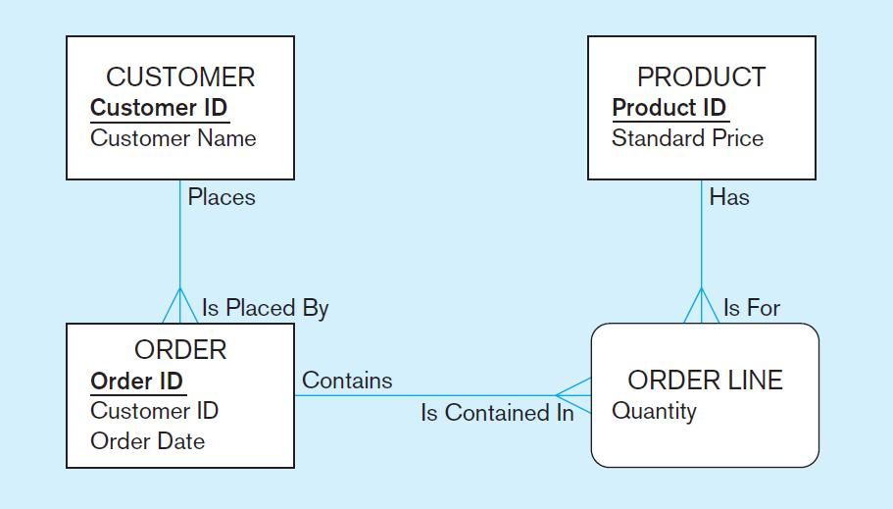
THE FOLLOWING SLIDES CREATE TABLES FOR THIS ENTERPRISE DATA MODEL
(from Chapter 1, Figure 1-3)
‹#›

Slide 42
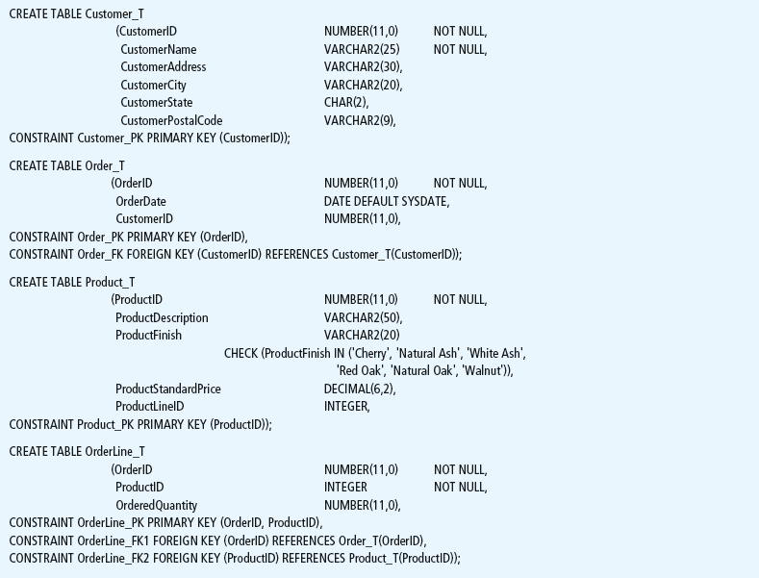
Figure 6-6 SQL database definition commands for Pine Valley Furniture Company (Oracle 11g)
Overall table definitions
‹#›

Slide 43
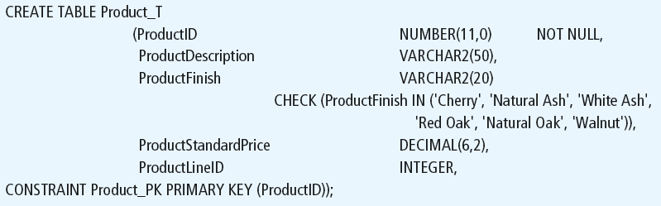
Defining attributes and their data types
Chapter 6
Copyright © 2014 Pearson Education, Inc.
‹#›
‹#›

Slide 44
Non-nullable specification
Primary keys can never have NULL values
Identifying primary key
Chapter 6
Copyright © 2014 Pearson Education, Inc.
‹#›
‹#›

Slide 45
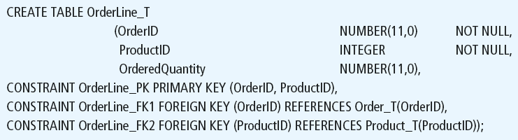
Non-nullable specifications
Primary key
Some primary keys are composite– composed of multiple attributes
Chapter 6
Copyright © 2014 Pearson Education, Inc.
‹#›
‹#›

Slide 46
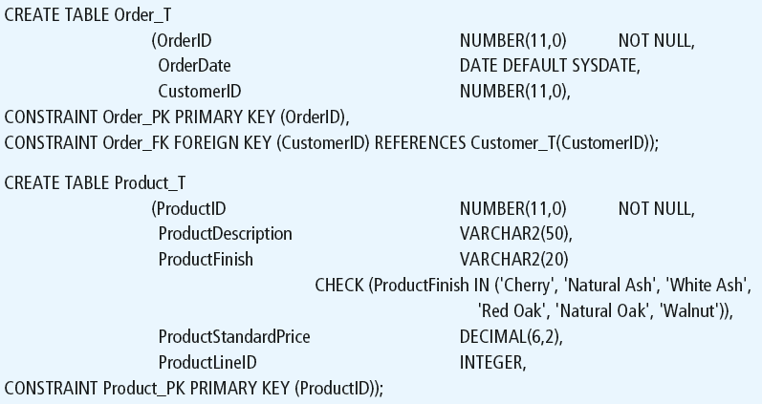
Controlling the values in attributes
Default value
Domain constraint
Chapter 6
Copyright © 2014 Pearson Education, Inc.
‹#›
‹#›

Slide 47
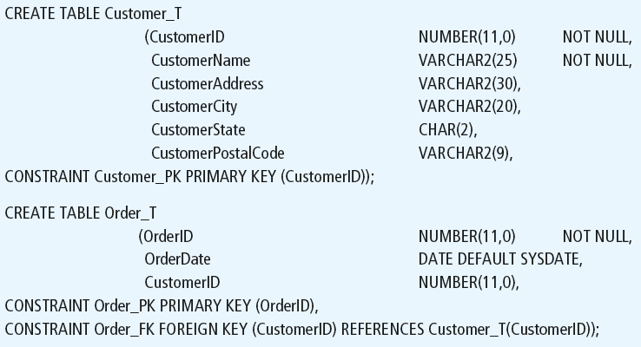
Identifying foreign keys and establishing relationships
Primary key of parent table
Foreign key of dependent table
Chapter 6
Copyright © 2014 Pearson Education, Inc.
‹#›
‹#›

Slide 48
DATA INTEGRITY CONTROLS
Referential integrity–constraint that ensures that foreign key values of a table must match primary key values of a related table in 1:M relationships
Restricting:
Deletes of primary records
Updates of primary records
Inserts of dependent records
‹#›

Slide 49

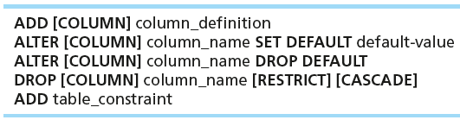

CHANGING TABLES
ALTER TABLE statement allows you to change column specifications:
Table Actions:
Example (adding a new column with a default value):
‹#›

Slide 50



INSERT STATEMENT
Adds one or more rows to a table
Inserting into a table
Inserting a record that has some null attributes requires identifying the fields that actually get data
Inserting from another table
‹#›

Slide 51
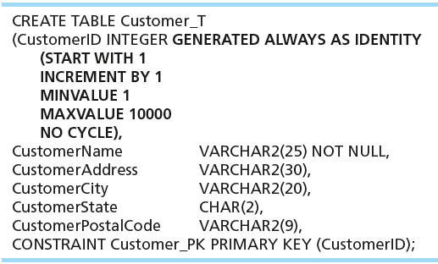
CREATING TABLES WITH IDENTITY COLUMNS
Introduced with SQL:2008
Inserting into a table does not require explicit customer ID entry or field list
INSERT INTO CUSTOMER_T VALUES ( ‘Contemporary Casuals’, ‘1355 S. Himes Blvd.’, ‘Gainesville’, ‘FL’, 32601);
‹#›

Slide 52
DELETE STATEMENT
Removes rows from a table
Delete certain rows
DELETE FROM CUSTOMER_T WHERE CUSTOMERSTATE = ‘HI’;
Delete all rows
DELETE FROM CUSTOMER_T;
‹#›

Slide 53

UPDATE STATEMENT
Modifies data in existing rows
‹#›

Slide 54
SCHEMA DEFINITION
Control processing/storage efficiency:
Choice of indexes
File organizations for base tables
File organizations for indexes
Data clustering
Statistics maintenance
Creating indexes
Speed up random/sequential access to base table data
Example
CREATE INDEX NAME_IDX ON CUSTOMER_T(CUSTOMERNAME)
This makes an index for the CUSTOMERNAME field of the CUSTOMER_T table
‹#›

Slide 55
SELECT STATEMENT
Used for queries on single or multiple tables
Clauses of the SELECT statement:
SELECT
List the columns (and expressions) to be returned from the query
FROM
Indicate the table(s) or view(s) from which data will be obtained
WHERE
Indicate the conditions under which a row will be included in the result
GROUP BY
Indicate categorization of results
HAVING
Indicate the conditions under which a category (group) will be included
ORDER BY
Sorts the result according to specified criteria
‹#›

Slide 56
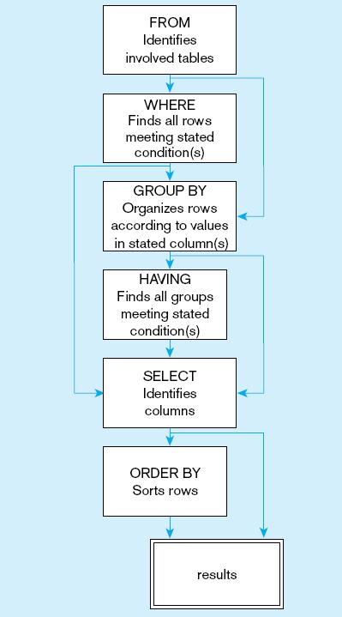
Figure 6-9
SQL statement processing order (based on van der Lans, 2006 p.100)
Chapter 6
Copyright © 2014 Pearson Education, Inc.
‹#›
‹#›

Slide 57
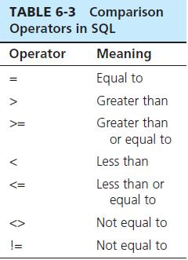

SELECT EXAMPLE
Find products with standard price less than $275
Table 6-3: Comparison Operators in SQL
‹#›

Slide 58
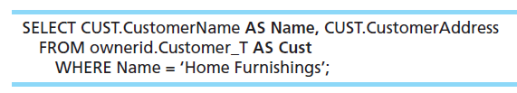
SELECT EXAMPLE USING ALIAS
Alias is an alternative column or table name
Here, CUST is a table alias and Name is a column alias
‹#›

Slide 59
SELECT EXAMPLE USING A FUNCTION
Using the COUNT aggregate function to find totals
SELECT COUNT(*) FROM ORDERLINE_T
WHERE ORDERID = 1004;
Note: with aggregate functions you can’t have single-valued columns included in the SELECT clause, unless they are included in the GROUP BY clause.
‹#›

Slide 60
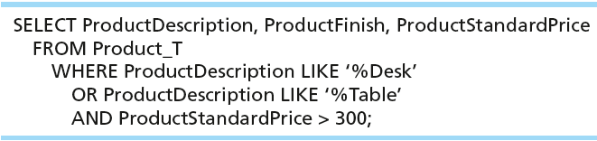
SELECT EXAMPLE–BOOLEAN OPERATORS
AND, OR, and NOT Operators for customizing conditions in WHERE clause
Note: the LIKE operator allows you to compare strings using wildcards. For example, the % wildcard in ‘%Desk’ indicates that all strings that have any number of characters preceding the word “Desk” will be allowed.
‹#›

Slide 61
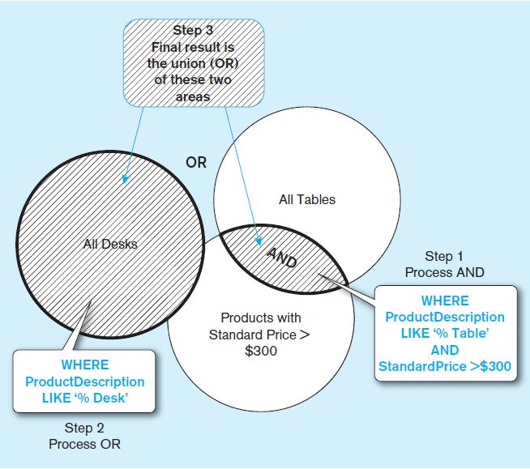
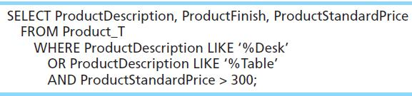
Figure 6-7 Boolean query A without use of parentheses
By default, processing order of Boolean operators is NOT, then AND, then OR
‹#›

Slide 62
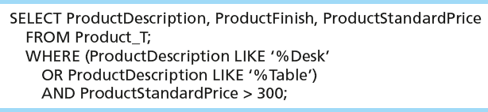
SELECT EXAMPLE–BOOLEAN OPERATORS
With parentheses…these override the normal precedence of Boolean operators
With parentheses, you can override normal precedence rules. In this case parentheses make the OR take place before the AND.
‹#›

Slide 63
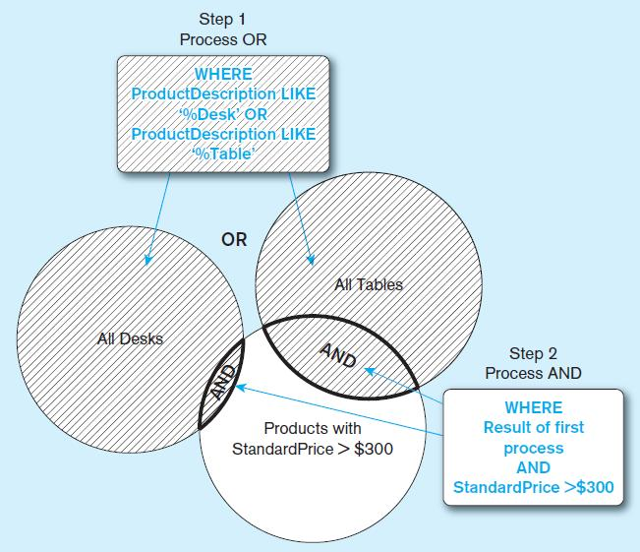
Figure 6-8 Boolean query B with use of parentheses
‹#›

Slide 64
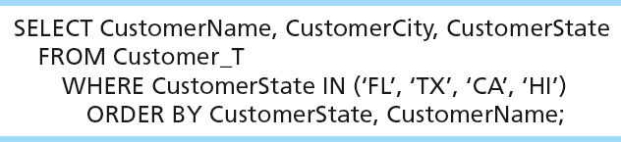
SORTING RESULTS WITH ORDER BY CLAUSE
Sort the results first by STATE, and within a state by the CUSTOMER NAME
Note: the IN operator in this example allows you to include rows whose CustomerState value is either FL, TX, CA, or HI. It is more efficient than separate OR conditions.
‹#›

Slide 65

CATEGORIZING RESULTS USING GROUP BY CLAUSE
For use with aggregate functions
Scalar aggregate: single value returned from SQL query with aggregate function
Vector aggregate: multiple values returned from SQL query with aggregate function (via GROUP BY)
You can use single-value fields with aggregate functions if they are included in the GROUP BY clause.
‹#›

Slide 66
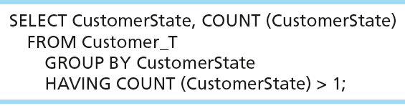
QUALIFYING RESULTS BY CATEGORIES USING THE HAVING CLAUSE
For use with GROUP BY
Like a WHERE clause, but it operates on groups (categories), not on individual rows. Here, only those groups with total numbers greater than 1 will be included in final result.
‹#›

Slide 67
USING AND DEFINING VIEWS
Views provide users controlled access to tables
Base Table–table containing the raw data
Virtual Table–constructed automatically as needed; not maintained as real data
Dynamic View
A “virtual table” created dynamically upon request by a user
No data actually stored; instead data from base table made available to user
Based on SQL SELECT statement on base tables or other views
Contents materialized as a result of a query
‹#›

Slide 68
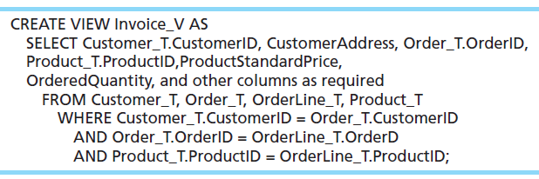
SAMPLE CREATE VIEW
Query: What are the data elements necessary to create an invoice for a customer?
Save this query as a view named Invoice_V.
‹#›

Slide 69
ADVANTAGES OF VIEWS
Simplify query commands
Assist with data security (but don't rely on views for security, there are more important security measures)
Enhance programming productivity
Contain most current base table data
Use little storage space
Provide customized view for user
Establish physical data independence
‹#›

Slide 70
DISADVANTAGES OF VIEWS
Use processing time each time view is referenced
May or may not be directly updateable
‹#›

